Slide 1
Devops Fundamentals

Slide 2
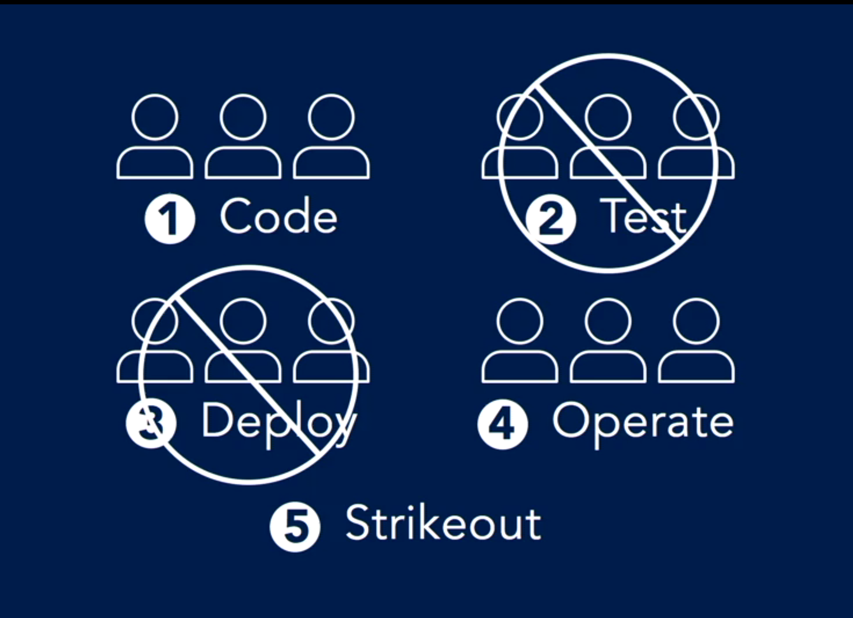
What is devops ?
Devops is the practice of operations and development engineers participating together through the entire service cycle, from the design and development process all the way to production support
2. Devops is also characterized by operations staff making use of many of the same techniques as developers for their system work.

Slide 3
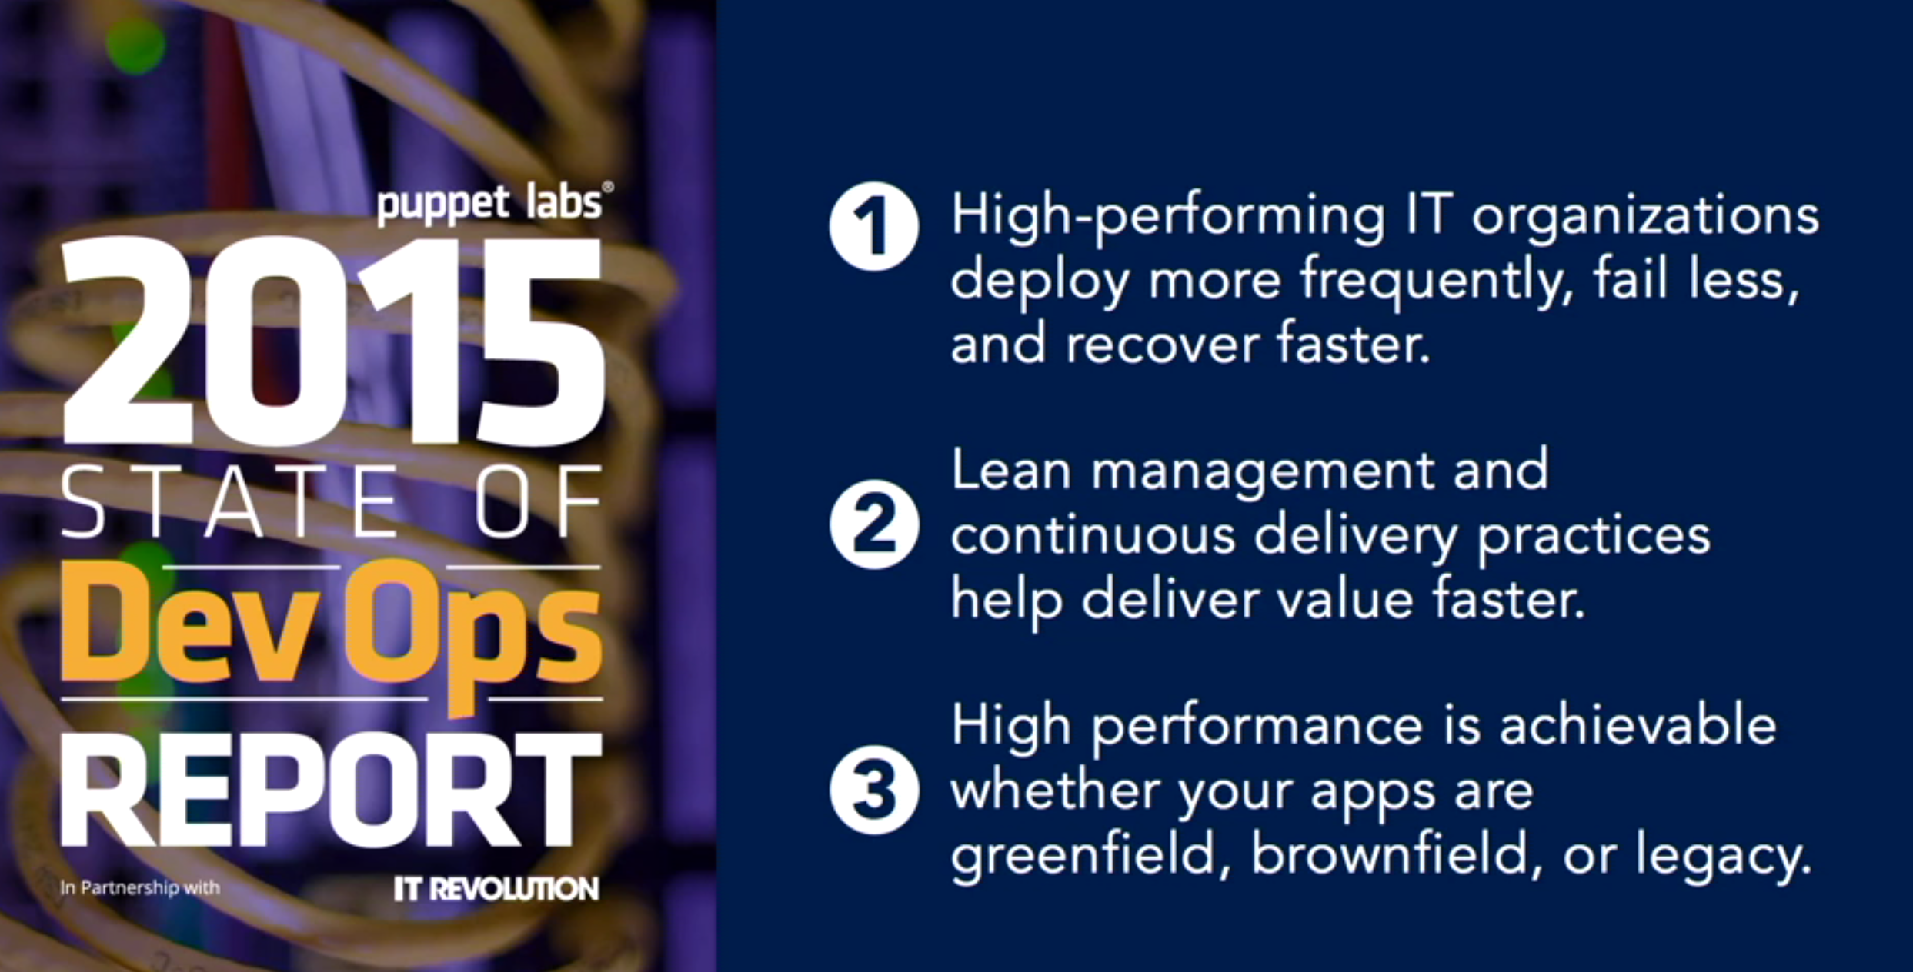
Why do we need Devops ?

Slide 4
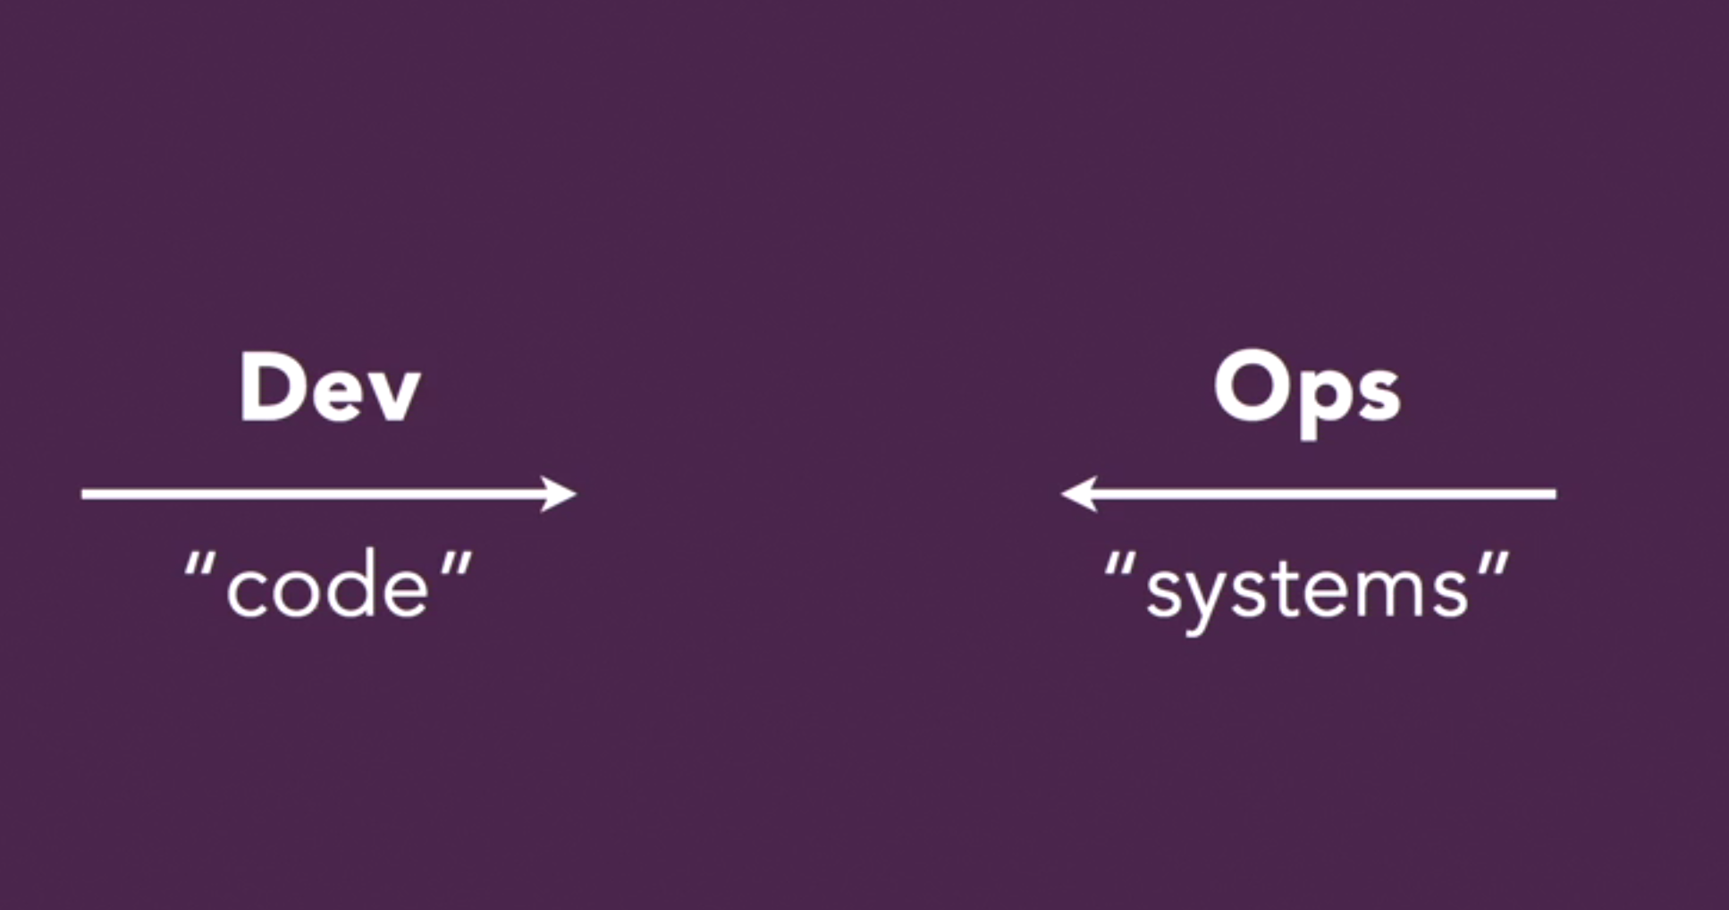
The five levels of devops
Values
Principles
Methods
Practices
Tools

Slide 5
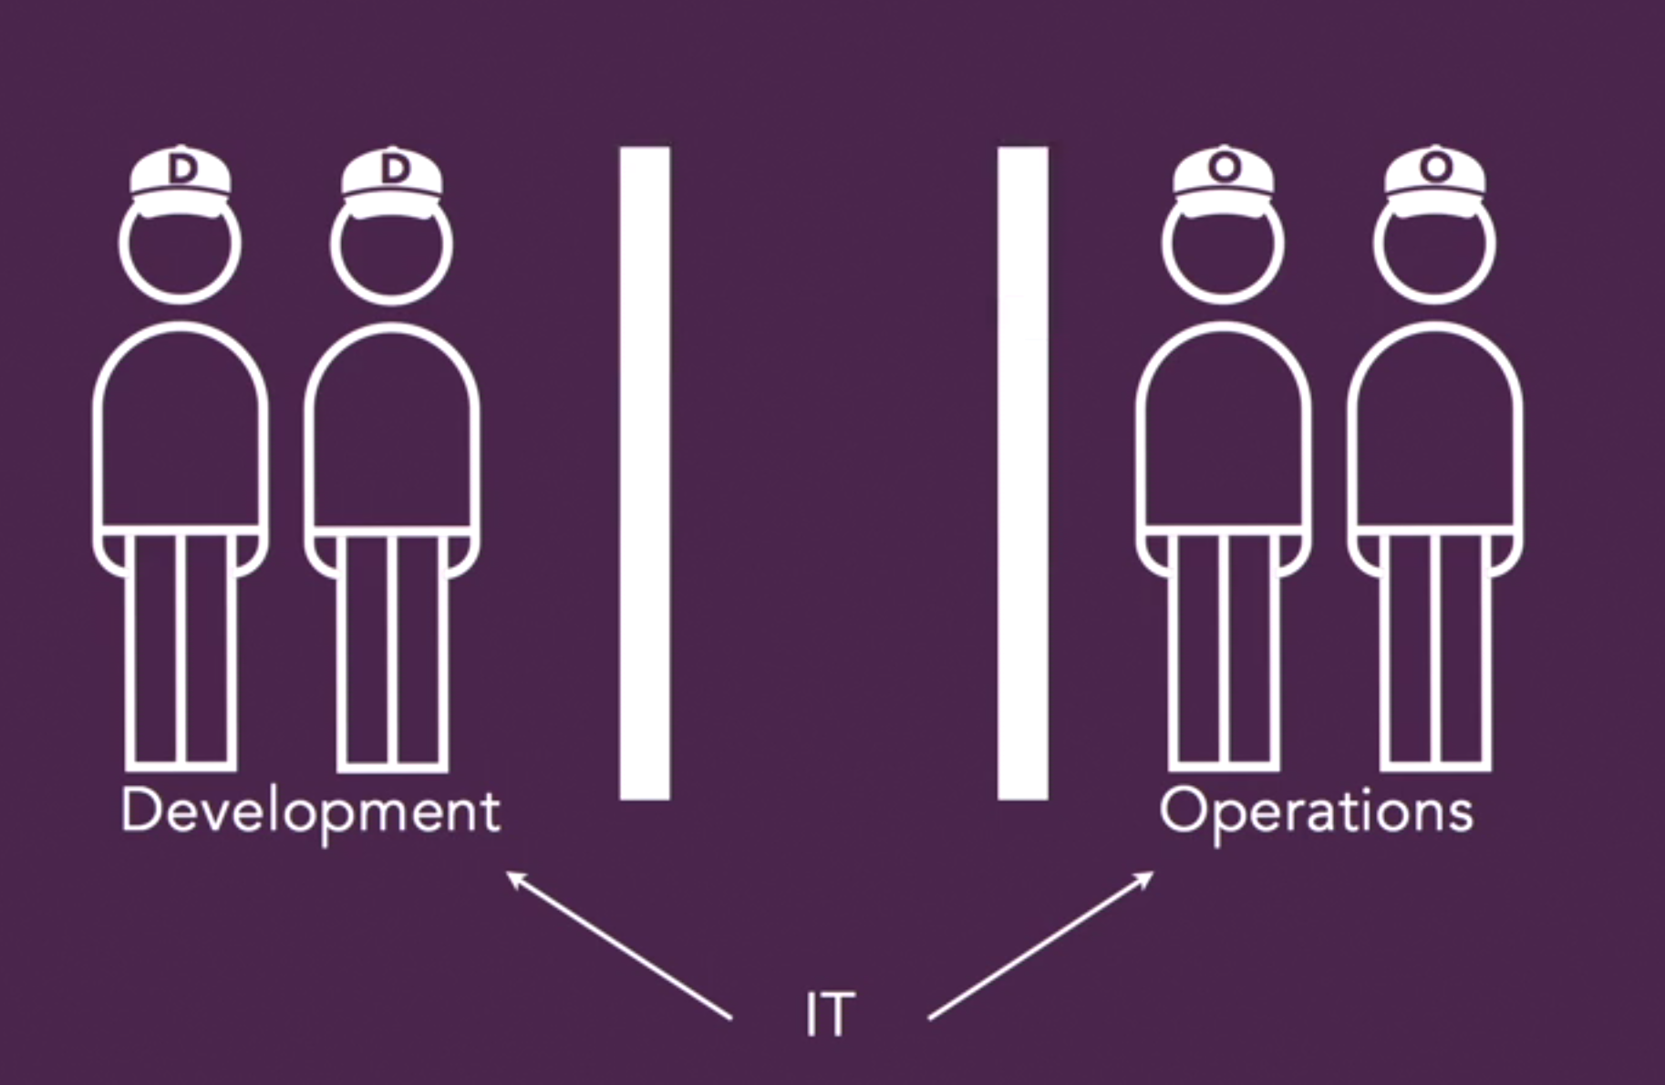
Devops core values : CAMS
Culture
Automation
Measurement
Sharing

Slide 6
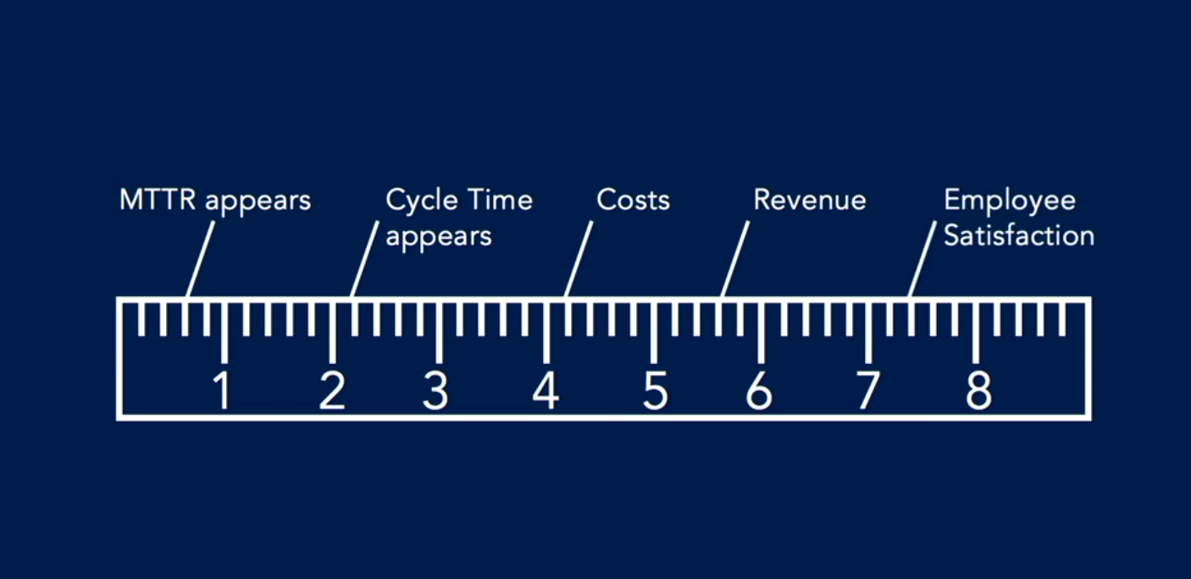
Metrics

Slide 7
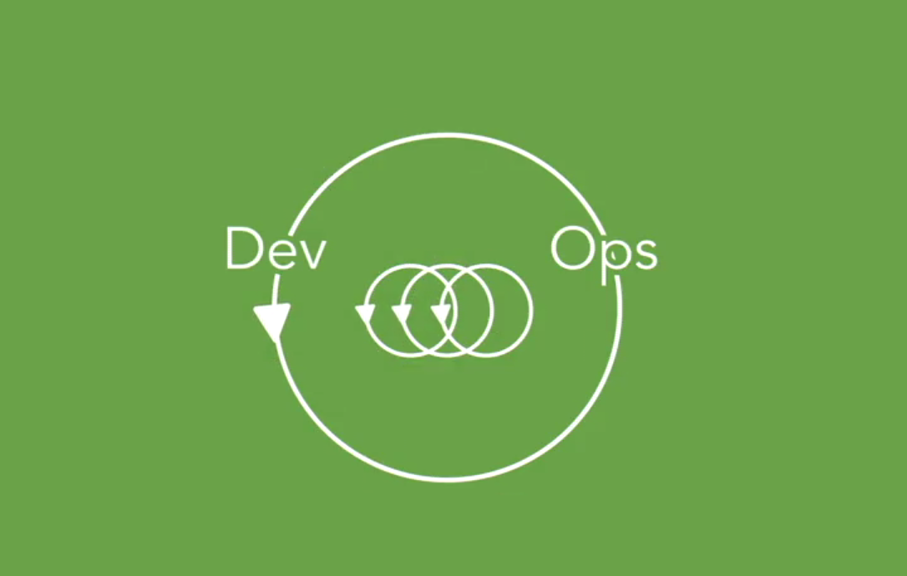
Feed back loops
Feedback is what drives any control loop designed to improve a system to use amplifying feedback loop to help you when you are creating multi-team process ,visualizing, metrics and design delivery flows.

Slide 8
Top 10 devops practices.
Incident command system
Developers on call
Status pages
Blameless postmortems
Embeded teams
The cloud (The API driven way )
Andon cord
Dependency Injection ( Focus on loosely coupled dependency )
Blue green deployment
The chaos Monkey

Slide 9
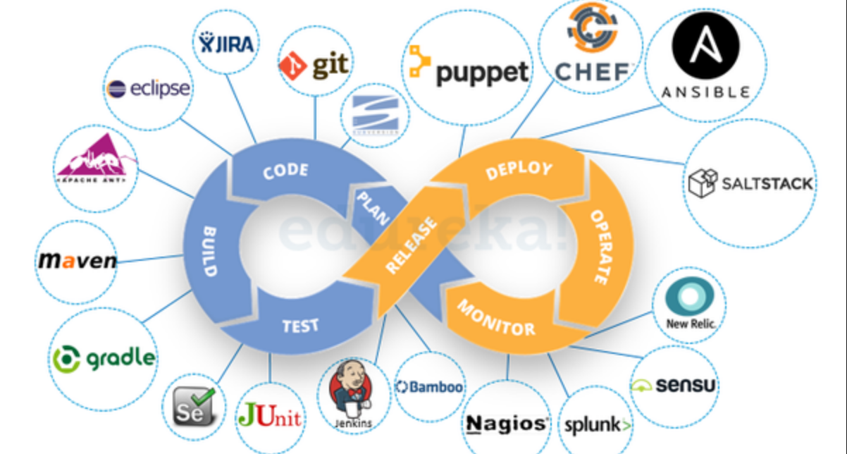
Devops tools
TRUST BUT VERIFY
1. SHOULD BE PROGRAMABLE
2. SHOULD BE SUPPORTED
3. WRITE YOUR OWN TOOLS

Slide 10
Infrastructure Automation

